Slide 1
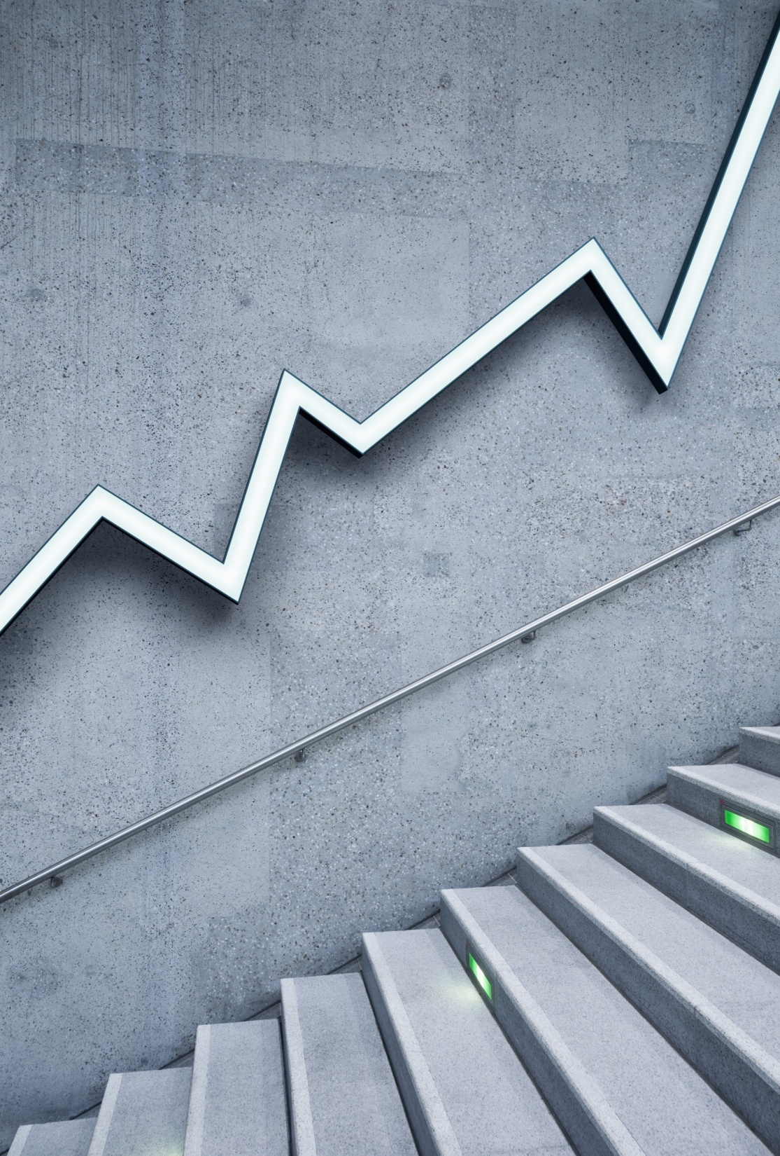
BLOCKCHAIN TECHNOLOGY
By:
B.S.N.V.B SATYA SAI
18NG1A0410

Slide 2
Contents
1. Abstract
2. Introduction
3. History
4. what is Blockchain?
5. Working of Blockchain
6. Proof of Work v/s Proof of stake
7. Applications
8. Advantages
9. Disadvantages
10. Conclusion

Slide 3
ABSTRACT
Blockchain technology is most simply defined as a decentralized, distributed collection of digital transactions that records the origin point of a digital asset. A blockchain is a database that stores encrypted blocks of data then chains them together to form a chronological single-source-of-truth for the data.
Digital assets are distributed instead of copied or transferred, creating an immutable record of an asset. The asset is decentralized, allowing full real-time access and transparency. Because the transaction involves little human interaction, there is a lower risk of error. As each transaction must be confirmed by a majority of the network nodes and recorded across the entire blockchain, the possibility that the information can be manipulated or altered is eliminated.
Blockchain is an especially promising and revolutionary technology because it helps reduce risk, stamps out fraud and brings transparency with many uses in different domains.
In recent days Blockchain technology is gaining prominence because of various crypto currencies like Bitcoin, Ethereum or Litecoin, which are being developed by using this block chain technology. Other domains in which this Blockchain technology has applications is Money Transfers and Payment Processing, Secure sharing of medical data, Anti-money laundering tracking system, postal department and for timely delivery of many government schemes and services.

Slide 4
INTRODUCTION
A blockchain is a growing list of data blocks that are linked together
Blockchain is the backbone Technology of Digital Crypto Currency Bit Coin. The blockchain is a distributed database of records of all transactions.
Blockchain can be defined as a chain of blocks that contains information. The technique is intended to timestamp digital documents so that it’s not possible to backdate them or temper them.
The purpose of blockchain is to solve the double records problem without the need for a central server.
The block chain is used for the secure transfer of items like money, property, contracts, etc, without requiring a third-party intermediary like a bank or government. Once data is recorded inside a blockchain, it is very difficult to change it.

Slide 5
INTRODUCTION
The blockchain is a software protocol (like SMTP is for email). However, Blockchains could not be run without the Internet. It is also called meta-technology as it affects other technologies. It is comprised of several pieces: a database, software application, some connected computers, etc.
Sometimes the term is used for Bitcoin Blockchain or The Ethereum Blockchain, and sometimes, it’s other virtual currencies or digital tokens. However, most of them are talking about distributed ledgers.
Blockchain is not Bitcoin, but it is the technology behind Bitcoin. Bitcoin is the digital token, and the blockchain is the ledger to keep track of who owns the digital tokens.
You can’t have Bitcoin without blockchain, but you can have a blockchain without Bitcoin.

Slide 6
HISTORY
2008: The first description of Bitcoin was published in 2008 by an individual or a group under the pseudonym “Satoshi Nakamoto” in a now very famous white paper.
2009: The Bitcoin Network goes live and the first Bitcoins are mined.
2010: The first cryptocurrency stock exchange for trading Bitcoin is launched.
2011: One Bitcoin equals one USD.
2013: One Bitcoin now equals 100 USD.
2014: Microsoft starts accepting Bitcoin as payments.
2017: One Bitcoin equals 10'000 USD.
The words block and chain were used separately in Satoshi Nakamoto's original paper, but were eventually popularized as a single word, blockchain, by 2016.
In August 2014, the bitcoin blockchain file size, containing records of all transactions that have occurred on the network, reached 20 GB (gigabytes). In January 2015, the size had grown to almost 30 GB, and from January 2016 to January 2017, the bitcoin blockchain grew from 50 GB to 100 GB in size. The ledger size had exceeded 200 GB by early 2020.

Slide 7
What is Blockchain?
A blockchain is a growing list of data blocks that are linked together.
Data
_____________
Reference
Data
______________
Reference
Data
____________
Reference

Slide 8
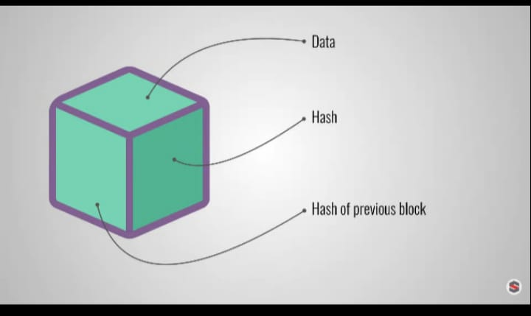
WORKING

Slide 9
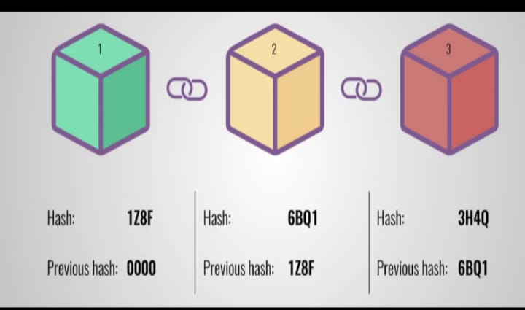
WORKING

Slide 10
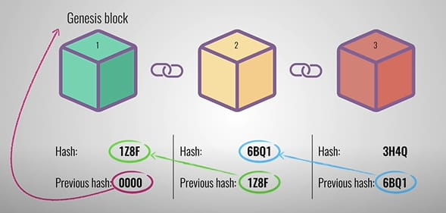
WORKING

Slide 11
EXPLANATION
. Each block also has a hash, which you can compare to a fingerprint. A hash identifies the block and all of its contents and is always unique, just as a fingerprint is. Once a block is created, its hash is calculated. Changing anything inside the block will cause the hash to change. In other words, hashes are very useful when you want to detect changes to blocks. If the hash of a block changes, it’s no longer the same block.
The third element inside each block is the hash of the previous block.. Let’s look at an example.
Here, we have a chain of three blocks. As you can see, each block contains its own hash and the hash of the previous block. So block number 3 points to block number 2, and block number 2 points to block number 1. Now, the first block is a bit special, as it cannot point to previous blocks because it’s the first. This block is called the genesis block.
Now, let’s say you tamper with the second block. This causes the hash of that block to change. In turn, that will make block 3 and all following blocks invalid because block 3 will no longer store a valid hash .

Slide 12
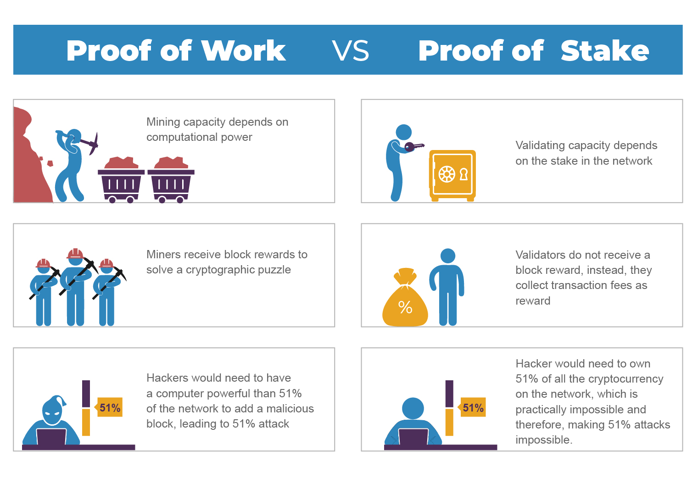

Slide 13
Applications
1. Secure sharing of medical data.
2. Cross-border payments.
3. Real-time IoT operating systems.
4. Personal identity security.

Slide 14
Advantages
1. Enhanced Security
2. Greater Transparency
3. Increased Efficiency
4. Automation

Slide 15
Disadvantages
1. High Cost
2. Self Maintenance

Slide 16
Conclusion
Blockchain technology is revolutionary. It will make life simpler and safer, changing the way personal information is stored and how transactions for good and services are made.
The Bitcoin is the first successful implementation of blockchain. Today, the world has found applications of blockchain technology in several industries, where the trust without the involvement of a centralized authority is desired.

Slide 17
THANK YOU

Slide 18
ANY QUERIES?

